Slide 1
Sentence-to-Book Classification
NLP Course Final Project

Slide 2
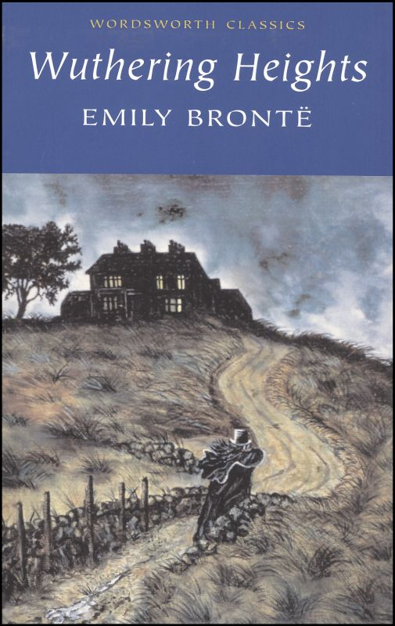
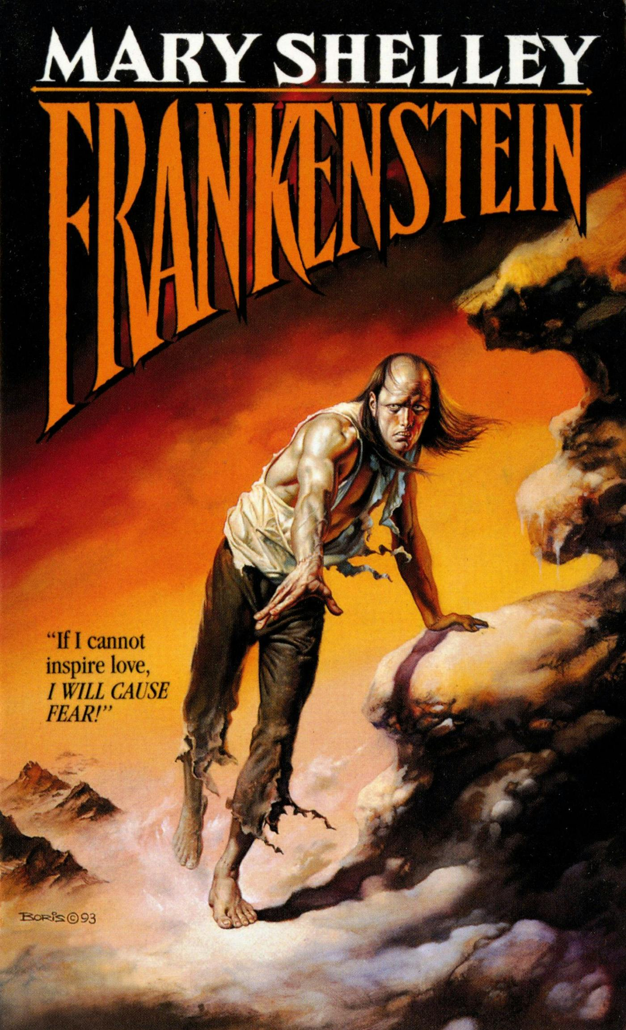
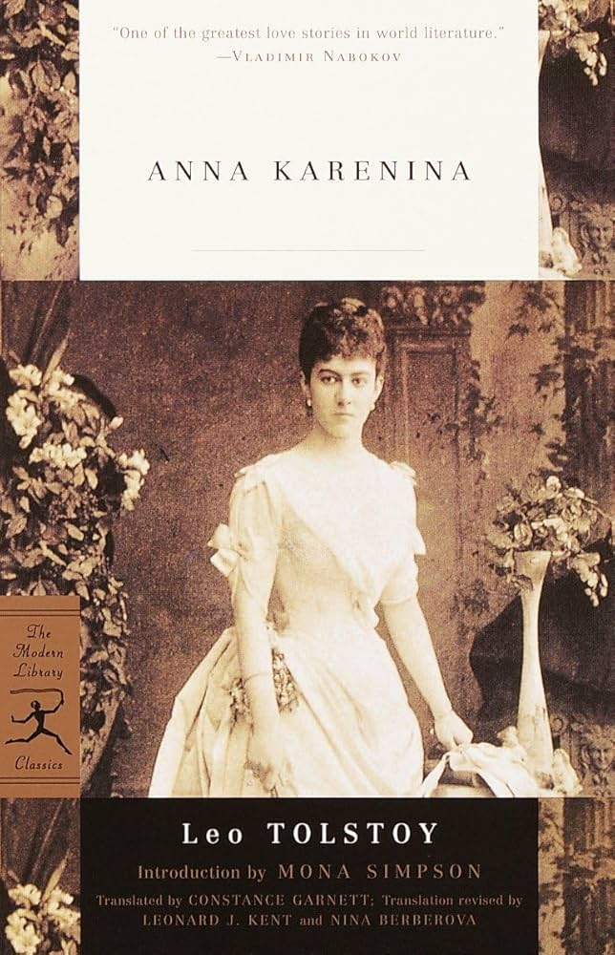
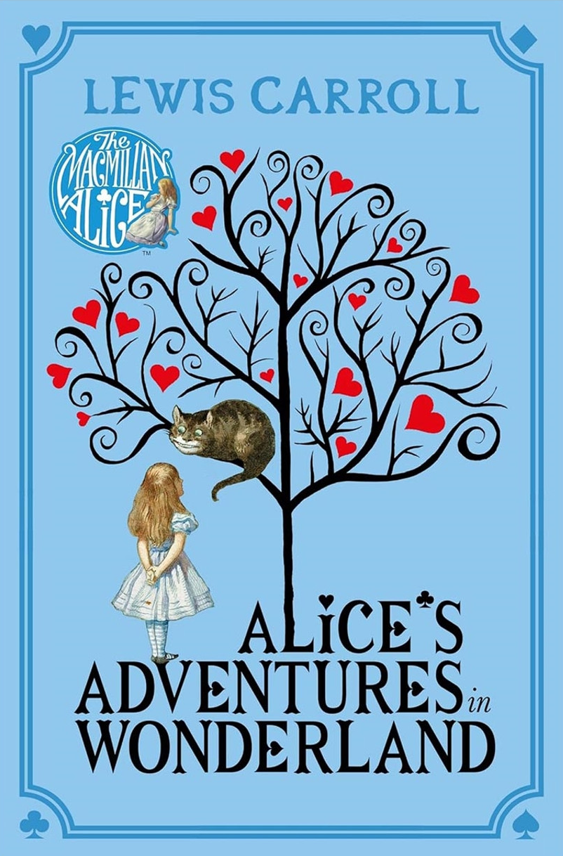
Introduction
Given a sentence, does it belong to the book?
No, I didn't, said Alice: I don t think it s at all a pity.

Slide 3
The Challange
The previous one was an easy one, but what about this?
But, away with you!
It comes from Wuthering Heights

Slide 4
The Challange
The previous was an easy one, but what about this?
But, away with you!
But Anna Karenina has a very similar sentence:
And go away, and go away!
It comes from Wuthering Heights
We want the model to understand the meaning of the sentences and classify them based on the meanings across the books.

Slide 5
The Challange
When two similar sentences are used once as a positive example and once as negative, it “confuses” the model
But, away with you!
And go away, and go away!

Slide 6
Our Goal
To train a model (or several models) that understands if a sentence belongs to the semantic realm of the book, even if it doesn’t actually appear in the book
But, away with you!

Slide 7
Why is that interesting?
A book is a constant corpus, so it is not that interesting,
but our methodology can be applied corpora when we want to –
Classify signals to channels, when overlapping is a common situation, without tagging any data using self-supervised approach

Slide 8
Our Methodology
Singal-Label Data
Semantic Model
Multi-Label Data
Classifier(s)
We used semantic similarity to create an augmented dataset, that artificially “copy” sentences from one book to the other and train the classifier on that.

Slide 9
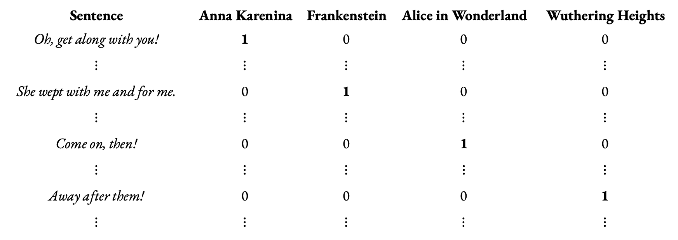
Singal-Label Data
Sentence | Anna Karenina | Frankenstein | Alice in Wonderland | Wuthering Heights
Oh, get along with you! $$⋮$$ | 1 $$⋮$$ | 0 $$⋮$$ | 0 $$⋮$$ | 0 $$⋮$$
She wept with me and for me. $$⋮$$ | 0 $$⋮$$ | 1 $$⋮$$ | 0 $$⋮$$ | 0 $$⋮$$
Come on, then! $$⋮$$ | 0 $$⋮$$ | 0 $$⋮$$ | 1 $$⋮$$ | 0 $$⋮$$
Away after them! $$⋮$$ | 0 $$⋮$$ | 0 $$⋮$$ | 0 $$⋮$$ | 1 $$⋮$$
Source: IsmaelMousa/books

